Slide 1
Lecture 9

Slide 2
Recap of lecture 8
Routing of queries and replication
Master node architecture
Two alternative designs:
All queries go through one master node
Clients go directly to data nodes, occasionally sync up with master node
Advantage: simple
Disadvantage: single point of failure
Distributed routing using consistent hashing
Advantage: no single point of failure, scalable
Disadvantage: worse performance (requires more communication)
Replication
Master replica replicates to secondary nodes
Need to maintain consistency
HDFS
Uses master node architecture
Master node is called NameNode, data is stored on DataNodes
Large immutable files
Serves as file system for many distributed databases and analytics systems, including Spark/MapReduce

Slide 3
Recap of lecture 8 (continued)
Distributed Transactions and 2PC
Each node has its own transaction coordinator and manager
Any node can originate a transaction via coordinator
2PC has two phases:
Prepare phase: coordinator sends a prepare message to all managers, waits for ready response
Decision phase: if it received a ready response from all the managers, it can commit transaction locally and send commit message to all other nodes
2PC ensures that transactions are either committed or aborted on all nodes
If any manager responds “not ready”, transaction must be aborted
Coordinator can only continue if gets “ready” from all participating nodes
2PC can block if participating nodes have a “ready” log, but no commit/abort
Need to wait to hear from coordinator
How to solve blocking?
Use distributed consensus, so that there are multiple coordinators, with a majority vote required

Slide 4
Today: MapReduce, Spark and Streaming
MapReduce
Analytics programming interface
Word count example
Chaining
Reading/write from/to HDFS
Dealing with failures
Spark
Motivation
Resilient Distributed Datasets (RDDs)
Programming interface
Transformations and actions
Stream processing
Motivation
Spark streaming
Programming model
Twitter example

Slide 5
Logistics
Almost done grading midterm
Should be done very soon, will announce it’s done
Class is pass/fail, so grades are all about personalized feedback for each one of you on how well you know the material
Syllabus
Classes will run until and including May 4
Instead of doing in-class midterm and final, we will be teaching
Will cover all material as planned originally, even though two classes were cancelled
Syllabus and materials are regularly updated on course website
Final
Similar format to midterm
Probably: 1 week window, starting after the last class
Will include all material of the class, with an emphasis on material taught in the second half

Slide 6
Computer Systems for Data Science Topic 6
MapReduce
Spark
Streaming

Slide 7
MapReduce
Borrowed from Jeff Ullman, Cristiana Amza and Indranil Gupta

Slide 8
MapReduce and Hadoop
SQL and ACID are a very useful set of abstractions
But: unnecessarily heavy for many tasks, hard to scale
MapReduce is a more limited style of programming designed for:
Easy parallel programming
Invisible management of hardware and software failures
Easy management of very-large-scale data
It has several implementations, including Hadoop, Flink, and the original Google implementation just called “MapReduce.
It is also used in Spark

Slide 9
MapReduce in a Nutshell
A MapReduce job starts with a collection of input elements of a single type.
Technically, all types are key-value pairs.
Apply a user-written Map function to each input element, in parallel.
Mapper applies the Map function to a single element.
Many mappers grouped in a Map task (the unit of parallelism).
Usually a single Map task is run on a single node/server
The output of the Map function is a set of 0, 1, or more key-value pairs.
The system sorts all the key-value pairs by key, forming key-(list of values) pairs.

Slide 10
In a Nutshell – (2)
Another user-written function, the Reduce function, is applied to each key-(list of values).
Application of the Reduce function to one key and its list of values is a reducer.
Often, many reducers are grouped into a Reduce task.
Each reducer produces some output, and the output of the entire job is the union of what is produced by each reducer.

Slide 11
MapReduce workflow
Input Data
Output Data
Worker
write
Output
File 0
local
write
Worker
Split 0
read
Split 1
Worker
Split 2
Output
File 1
Worker
Worker
Remote read,
sort
Map
extract something you care about from each record
Reduce aggregate, summarize, filter, or transform

Slide 12
Example: Word Count
We have a large file of documents (the input elements).
Documents are words separated by whitespace.
Count the number of times each distinct word appears in the file.

Slide 13
Word Count Using MapReduce
map(key, value):
// key: document ID; value: text of document
FOR (each word w IN value)
emit(w, 1);
Expect to be all 1’s, but
“combiners” allow local summing of
integers with the same
key before passing to
reducers.
reduce(key, value-list):
// key: a word; value-list: a list of integers
result = 0;
FOR (each integer v on value-list)
result += v;
emit(key, result);

Slide 14
Mapper
Reads in input pair <Key,Value>
Outputs a pair <K’, V’>
Let’s count number of each word in user queries (or Tweets/Blogs)
The input to the mapper will be <queryID, QueryText>:
<Q1,“The teacher went to the store. The store was closed; the store opens in the morning. The store opens at 9am.” >
The output would be:
<The, 1> <teacher, 1> <went, 1> <to, 1> <the, 1> <store,1> <the, 1> <store, 1> <was, 1> <closed, 1> <the, 1> <store,1> <opens, 1> <in, 1> <the, 1> <morning, 1> <the 1> <store, 1> <opens, 1> <at, 1> <9am, 1>

Slide 15
Reducer
Accepts the Mapper output, and aggregates values on the key
For our example, the reducer input would be:
<The, 1> <teacher, 1> <went, 1> <to, 1> <the, 1> <store, 1> <the, 1> <store, 1> <was, 1> <closed, 1> <the, 1> <store, 1> <opens,1> <in, 1> <the, 1> <morning, 1> <the 1> <store, 1> <opens, 1> <at, 1> <9am, 1>
The output would be:
<The, 6> <teacher, 1> <went, 1> <to, 1> <store, 3> <was, 1> <closed, 1> <opens, 1> <morning, 1> <at, 1> <9am, 1>
Notes:
Input is typically sorted, output is output exactly as is
All inputs with the same key must go to the same reducer!

Slide 16
Another example: Chaining MapReduce
Count of URL access frequency
Input: Log of accessed URLs, e.g., from proxy server
Output: For each URL, % of total accesses for that URL
First step:
Map – process web log and outputs <URL, 1>
Multiple Reducers - Emits <URL, URL_count>
(So far, like Wordcount. But still need %)
Chain another MapReduce job after above one
Map – processes <URL, URL_count> and outputs <1, (<URL, URL_count> )>
1 Reducer – Does two passes. In first pass, sums up all URL_count’s to calculate overall_count. In second pass calculates %’s
Emits multiple <URL, URL_count/overall_count>
16

Slide 17
MapReduce
HDFS
NameNode
Master
assign
map
assign
reduce
Input Data
Output Data
Worker
write
Output
File 0
Split 0
local
write
Worker
Split 0
Split 1
Worker
Split 2
Split 1
Output
File 1
Worker
Read from HDFS DataNode
Worker
remote
read,
sort
Split 2
Write to HDFS DataNode
Map
Reduce
Notes:
Master scheduling policy:
Asks GFS for locations of replicas of input file blocks
Map tasks scheduled so GFS input block replica are on same machine or same rack
Effect: Thousands of machines read input at local disk speed
Eliminate network bottleneck!

Slide 18
Locality Optimization
Master scheduling policy:
Asks HDFS for locations of replicas of input file blocks
Map tasks scheduled so HDFS input block replica are on same machine or same rack
Effect: Thousands of machines read input at local disk speed
Don’t need to transfer input data all over the cluster over the network: eliminate network bottleneck!

Slide 19
Failure in MapReduce
Failures are the norm in data centers
Worker failure
Master detects if workers failed by periodically pinging them (this is called “heartbeat”)
Re-execute in-progress map/reduce tasks
Master failure
Single point of failure; Resume from Execution Log
Robust
Google’s experience: lost 1600 of 1800 machines once, but finished fine

Slide 20
Refinement: Redundant Execution
Slow workers or stragglers significantly lengthen completion time
Slowest worker can determine the total latency!
This is why many systems measure 99th percentile latency
Other jobs consuming resources on machine
Bad disks with errors transfer data very slowly
Solution: spawn backup copies of tasks
Whichever one finishes first "wins”
I.e., treat slow executions as failed execute
Notes:
Effect: Dramatically shortens job completion time

Slide 21
Spark
Borrowed from Indranil Gupta, Faria Kalim, Patrick Wendell

Slide 22
Motivation
Map reduce based tasks are slow
Data written to and read from storage
In the beginning and end of each Map and Reduce task
Iterative algorithms not supported
Need to chain map reduce jobs → cumbersome, need to know how many jobs in advance (hard to do a loop)
No support for interactive data mining and analytics

Slide 23
Spark’s Key Concept: Resilient Distributed Datasets (RDDs)
A form of distributed shared memory
Eliminates the need to read/write to/from disk intermediate data between iterations
Read only / immutable, partitioned collections of records in memory
Deterministic
Formed by specific operations (map, filter, join, etc.)
Can be read from stable storage or other RDDs
More expressive interface than MapReduce
Transformations (e.g. map, filter, groupBy)
Actions (e.g. count, collect, save)
Recent versions of Spark introduced Datasets/Dataframes
Like an RDD, but you can run SQL queries over it
Organized into rows columns, similar to DB relation
Notes:
Persistence - Users can specify which which RDD to keep in memory for later use
Partitioning – User can specify the hash over the clusters to use the

Slide 24
Spark programming interface
Lazy operations
Transformations not done until action
Operations on RDDs
Transformations - build new RDDs
Can include both traditional map and/or reduce operations
Actions - compute and output results
E.g., to a file, to a Python collection
Partitioning – layout across nodes
Persistence – final output can be stored on disk

Slide 25
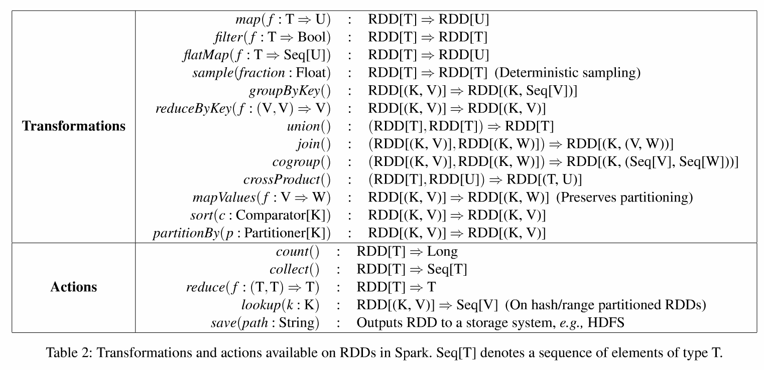
RDD on Spark
Notes:
A lot of these transformations will be familiar to you if you know SQL
Reduce by key is kind of aggregation on the sequence V

Slide 26

Example: Log Mining
Load error messages from a log into memory, then interactively search for various patterns
Base RDD
Transformed RDD
Cache 1
lines = spark.textFile(“hdfs://...”)
errors = lines.filter(lambda s: s.startswith(“ERROR”))
messages = errors.map(lambda s: s.split(“\t”)[2])
messages.cache()
results
Worker
tasks
Block 1
Driver
Action
messages.filter(lambda s: “mysql” in s).count()
Cache 2
messages.filter(lambda s: “php” in s).count()
Worker
Cache 3
. . .
Full-text search of Wikipedia
60GB on 20 EC2 machine
0.5 sec vs. 20s for on-disk
Worker
Block 2
Block 3
Notes:
Cache forces the execution

Slide 27
Fault Recovery
RDDs track lineage information that can be used to efficiently recompute lost data
msgs = textFile.filter(lambda s: s.startsWith(“ERROR”))
.map(lambda s: s.split(“\t”)[2])
HDFS File
Filtered RDD
Mapped RDD
filter (func = startsWith(…))
map (func = split(...))

Slide 28
Creating RDDs
# Turn a Python collection into an RDD
sc.parallelize([1, 2, 3])
# Load text file from local FS, HDFS, or S3
sc.textFile(“file.txt”)
sc.textFile(“directory/*.txt”)
sc.textFile(“hdfs://namenode:9000/path/file”)

Slide 29
Basic Transformations
nums = sc.parallelize([1, 2, 3])
# Pass each element through a function
squares = nums.map(lambda x: x*x) // {1, 4, 9}
# Keep elements passing a predicate
even = squares.filter(lambda x: x % 2 == 0) // {4}
# Map each element to zero or more others
nums.flatMap(lambda x: => range(x))
# => {0, 0, 1, 0, 1, 2}
Range object (sequence of numbers 0, 1, …, x-1)
Notes:
All lazy

Slide 30
Basic Actions
nums = sc.parallelize([1, 2, 3])
# Retrieve RDD contents as a local collection
nums.collect() # => [1, 2, 3]
# Return first K elements
nums.take(2) # => [1, 2]
# Count number of elements
nums.count() # => 3
# Merge elements with an associative function
nums.reduce(lambda x, y: x + y) # => 6
# Write elements to a text file
nums.saveAsTextFile(“hdfs://file.txt”)
Notes:
Reminder: actions take RDDs, output a file, or a collection or a number
Take is a really helpful action – if you’re working on a huge RDD, it allows you to output the first k elements instead to understand the layout of the RDD
Reduce in this case takes a function and outputs it back as a number

Slide 31
Working with Key-Value Pairs
Spark’s “distributed reduce” transformations operate on RDDs of key-value pairs
Python: pair = (a, b) pair[0] # => a pair[1] # => b

Slide 32
Some Key-Value Operations
pets = sc.parallelize( [(“cat”, 1), (“dog”, 1), (“cat”, 2)])
pets.reduceByKey(lambda x, y: x + y) # => {(cat, 3), (dog, 1)}
pets.groupByKey() # => {(cat, [1, 2]), (dog, [1])}
pets.sortByKey() # => {(cat, 1), (cat, 2), (dog, 1)}

Slide 33
Example: Word Count
lines = sc.textFile(“hamlet.txt”)
counts = lines.flatMap(lambda line: line.split(“ ”)) .map(lambda word => (word, 1)) .reduceByKey(lambda x, y: x + y)
“to” “be” “or”
(to, 1) (be, 1) (or, 1)
(be, 2) (not, 1)
“to be or”
“not” “to” “be”
(not, 1) (to, 1) (be, 1)
“not to be”
(or, 1)
(to, 2)
Notes:
We flatmap to get a map of all the words (not line by line)

Slide 34
More RDD Operators
map
filter
groupBy
sort
union
join
leftOuterJoin
rightOuterJoin
reduce
count
fold
reduceByKey
groupByKey
cogroup
cross
zip
sample
take
first
partitionBy
mapWith
pipe
save ...

Slide 35
Under The Hood: DAG Scheduler
General task graphs
Automatically pipelines functions
Data locality aware
Partitioning aware to avoid shuffles
B:
A:
F:
Stage 1
groupBy
C:
D:
E:
join
Stage 2
map
filter
Stage 3
= RDD
= cached partition
Notes:
NOT a modified version of Hadoop
The lazy operations help the scheduler construct the DAG

Slide 36
Lecture 10

Slide 37
Recap of lecture 9
MapReduce
A programming interface that is tailored for distributed computation
Gave up on SQL
Map takes an input file and maps it to key, value pairs
Reduce aggregates on all the values of a particular key
MapReduce can be chained for more complicated queries
Requires reading/writing from/to storage at each step
Tightly integrated with Hadoop File System
Limitations: storage slows every step down, not good for ”foor-loops” or complicated iterative queries

Slide 38
Recap of lecture 9 (continued)
Spark
Much more expressive programming interface than MapReduce
Supports Python/SQL/R/…
Uses memory for all intermediate steps
Memory is stored in RDDs (and these days in Dataframes and Datasets)
RDDs are read-only
Basic idea: apply transformations on RDDs, and an action as the final output
Transformations are deterministic, and can be replayed
Uses a DAG (Directed Acyclic Graph) to schedule tasks and tracks lineage to re-compute data on failed nodes
Does not replicate RDDs

Slide 39
Today: UDF and Regex, Streaming, Caching
Spark (continued)
UDF (User Defined Functions)
Regular expressions (Regex)
Stream processing
Motivation
Spark streaming
Programming model
Twitter example
Caching
FIFO
LRU
LFU
…

Slide 40
Logistics
Midterm grading is done
More resources for Spark homework
Hongyi posted some more resources on Piazza
We will now discuss some extra Spark topics that may be useful for the homework assignment
Please conserve credits
This is good practice for the course and for life!
It’s inconvenient, but shut down your VMs after you are done working

Slide 41
SQL on Spark
Spark SQL allows you to use SQL on Spark
Instead of using RDDs, it uses DataFrames
Like an RDD, but in a table format
Each column has a name
A few useful operations:
df.collect()
[Row(price=100, company=‘Ford’),
Row(price=5, company=‘VW’)]
df.columns
[‘price’, ‘company’]
df.count()
2
df.filter(df.price > 50).collect()
[Row(price=100, company=‘Ford’)]
Return records as a list
Returns column format
Returns number of rows
Filters

Slide 42
User-Defined Functions (UDF) in Spark
Sometimes you need to write a custom operation that is run on each row
Cleaning/mapping/filtering strings
Custom math operation
For example:
For a column that contains names, remove all middle names and just keep first and last name
Extract the name of the service from an error log
Change the names “Nick, Rick” to “Nicholas, Richard”
UDF allows you to define a new custom function that will be applied to each row
Word of caution: be sure to consider NULL case
Most commonly within the UDF itself
Need to register UDF function (different name than the Python function)

Slide 43
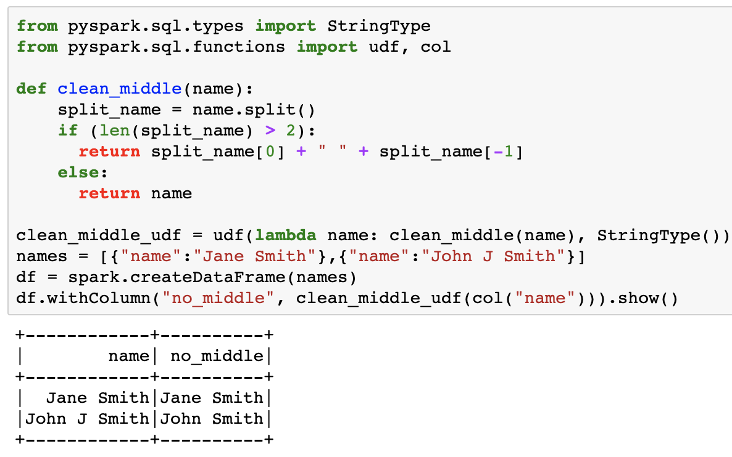
UDF Example

Slide 44
UDF Example (raw text)
from pyspark.sql.types import StringType
from pyspark.sql.functions import udf, col
def clean_middle(name):
split_name = name.split()
if (len(split_name) > 2):
return split_name[0] + " " + split_name[-1]
else:
return name
clean_middle_udf = udf(lambda name: clean_middle(name), StringType())
names = [{"name":"Jane Smith"},{"name":"John J Smith"}]
df = spark.createDataFrame(names)
df.withColumn("no_middle", clean_middle_udf(col("name"))).show()

Slide 45
Regular expressions (Regex)
A scripting language for matching and/or manipulating strings of text
Manipulating text with built-in Python string functions can be cumbersome
Python and PySpark support regex
Examples of operations
Find all substrings with “helloworld” and replace with: “Hello World”
Find all substrings with “fox”, but exclude “foxtrot”, and replace with the word ”wolf”
Remove all special characters (e.g., !%&), punctuation (e.g., .,;:)
Useful in many programming contexts
Spark
Python
SQL
Etc.
Hint: can be useful in homework assignment (coupled with a UDF perhaps?)
Use free online regex tool for debugging: https://regex101.com/

Slide 46
Regex matching examples
Text: fox foxtrot ox box
fox: fox foxtrot ox box
ox: fox foxtrot ox box
fox\w: fox foxtrot ox box (\w matches any word character)
fox\w*: fox foxtrot ox box (* matches zero or more of the preceding character)
fox\w+: fox foxtrot ox box (+ matches one or more of the preceding character)
[^f]ox: fox foxtrot ox box (without the letter f in the beginning)
[^f\W]ox: fox foxtrot ox box (without the letter f or a non-word character)
[bf]ox: fox foxtrot ox box (match on b or f followed by ox)

Slide 47
Stream Processing
Borrowed from Tathagata Das and Indranil Gupta

Slide 48
Motivation
Large amounts of data => Need for real-time views of data
Social network trends, e.g., Twitter real-time search
Website statistics, e.g., Google Analytics
Intrusion detection systems, e.g., in most datacenters
Process large amounts of data
With latencies of few seconds
With high throughput

Slide 49
Would MapReduce or normal Spark work?
Batch Processing => need to wait for entire computation on large dataset to complete
Not intended for long-running and real-time stream-processing

Slide 50
Which one of these is a stream processing job?
A) Uber
Calculating surge prices
B) LinkedIn
Aggregating updates into one email
C) Netflix
Understanding user behavior to improve personalization
D) TripAdvisor
Calculating earnings per day & fraud detection
E) All of them

Slide 51
Discretized Stream Processing
Run a streaming computation as a series of very small, deterministic batch jobs
Batch processing models, like MapReduce, recover from faults and stragglers efficiently
Divide job into deterministic tasks
Rerun failed/slow tasks in parallel on other nodes
Same recovery techniques at lower time scales
Transformations are not lost (or performed twice) if a worker dies

Slide 52
Spark Streaming
State between batches kept in memory as immutable, fault-tolerant dataset
Specifically as an RDD/Dataframe/Dataset
Batch sizes can be reduced to as low as 1/2 second to achieve ~ 1 second latency
Combines streaming and batch workloads
Many other alternatives:
Apache Storm
Apache Flink
Amazon Kinesis
Google Dataflow
…

Slide 53
Discretized Stream Processing
batch operations
input
state / output
immutable
distributed dataset
(replicated in memory)
immutable distributed dataset, stored in memory as RDD
time = 0 - 1:
input
time = 1 - 2:
…
…
…
input stream
state stream

Slide 54
Fault Recovery
State stored as RDD
Deterministically re-computable parallel collection
Remembers lineage of operations used to create them
Fault / straggler recovery is done in parallel on other nodes
operation
input dataset
(replicated and
fault-tolerant)
state RDD
(not replicated)
Fast recovery from faults without full data replication

Slide 55
Programming Model
A Discretized Stream or DStream is a series of RDDs representing a stream of data
API very similar to RDDs
DStreams can be created…
Either from live streaming data
Or by transforming other DStreams

Slide 56
DStream Data Sources
Many data sources can be inupts
HDFS
Kafka
Flume
Twitter
…

Slide 57
Transformations
Build new streams from existing streams
Filters/aggregate operations
map, flatMap, filter, count, reduce,
groupByKey, reduceByKey, sortByKey, join
etc.
New window and stateful operations
window, countByWindow, reduceByWindow
countByValueAndWindow, reduceByKeyAndWindow
updateStateByKey
etc.

Slide 58
Output Operations
Send data to outside world
saveAsHadoopFiles
print – prints on the driver’s screen
foreach - arbitrary operation on every RDD

Slide 59
Example
Process a stream of Tweets to find the 20 most popular hashtags in the last 10 mins
Get the stream of Tweets and isolate the hashtags
Count the hashtags over 10 minute window

Slide 60
1. Get the stream of Hashtags
tweets = ssc.twitterStream(username, password)
hashtags = tweets.flatMap (lambda tweet: tweet.getTags())
DStream
transformation
= RDD
t-1
t
t+1
t+2
t+3
t+4
tweets
flatMap
flatMap
flatMap
flatMap
flatMap
hashTags
Notes:
Flatmap is just like map, except it outputs multiple values – in this case multiple tags

Slide 61
2. Count the hashtags over 10 min
Window length
Sliding interval
tweets = ssc.twitterStream(username, password)
hashtags = tweets.flatMap (lambda tweet: tweet.getTags())
tagCounts = hashTags.window(Minutes(10), Seconds(1)).countByValue()
t-1
t
t+1
t+2
t+3
t+4
hashTags
tagCounts

Slide 62
2. Count the hashtags over 10 min
tweets = ssc.twitterStream(username, password)
hashtags = tweets.flatMap (lambda tweet: tweet.getTags())
tagCounts = hashtags.countByValueAndWindow(Minutes(10), Seconds(1))
t-1
t
t+1
t+2
t+3
t+4
hashTags
countByValue
Subtract the counts from the batch before the window
Add the counts from the new batch in the window
–
+
tagCounts
+

